Slide 1
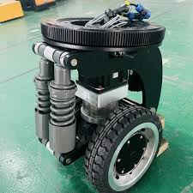
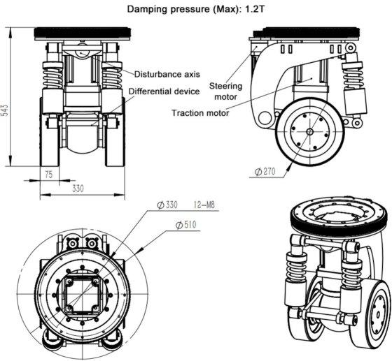

Autonomous Mobile Robots & Vehicles
Devank Thawre
N12801755
Chosen Platform:
Two Wheeled Differential Drive Robot
! GitHub Link !

Slide 2
Why I chose this
Platform
It's a simple, cost-effective, and highly maneuverable design that allows for spinning in place which I think is a huge advantage in tight environments.
As a well-established platform, it also comes with extensive support and research, making it a very practical option.

Slide 3
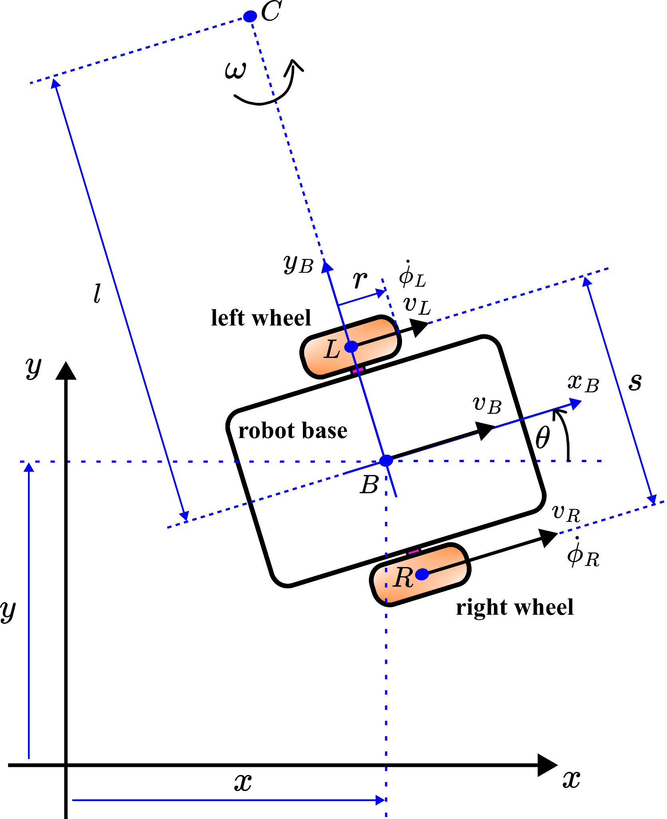
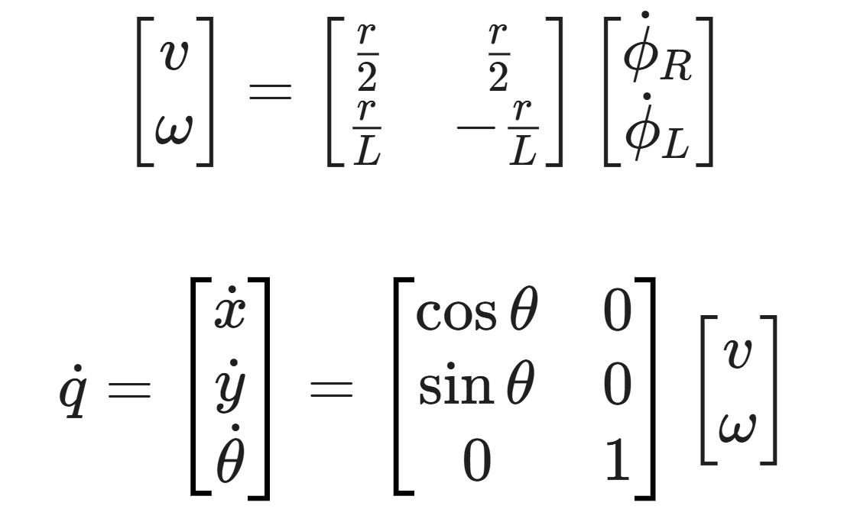
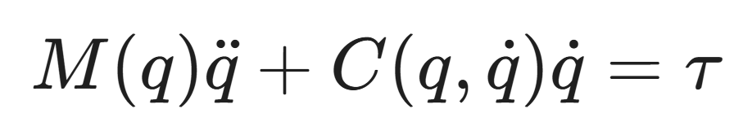
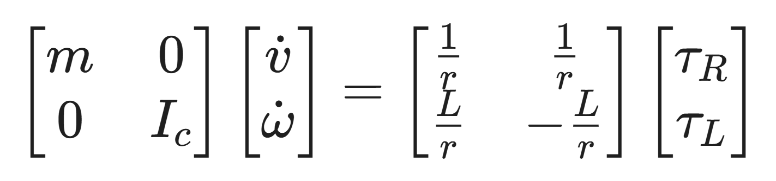
SYSTEM MODELLING
Kinematics:
Velocities (v,w)
State Space
Dynamics:
The relationship between motor torques (tau) and robot acceleration (q):
For our idealized differential drive robot:

Slide 4
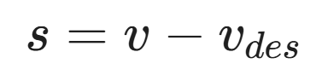
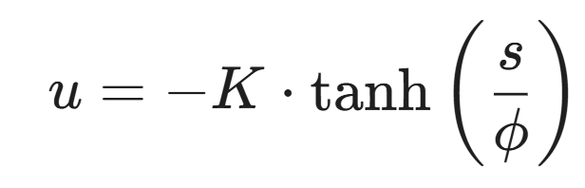
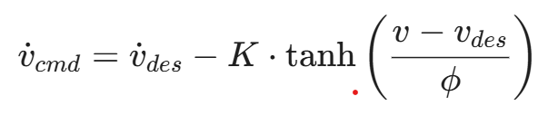
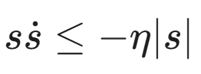
CONTROL METHODOLOGY
Sliding Surface: Defining the error surface the controller tries to maintain (𝒔 = 0):
Control Law (with Boundary Layer): The robust control output used to eliminate chattering:
Where 𝝓 is the boundary layer thickness.
Lyapunov Stability Condition: The mathematical guarantee that the error will converge to zero:

Slide 5
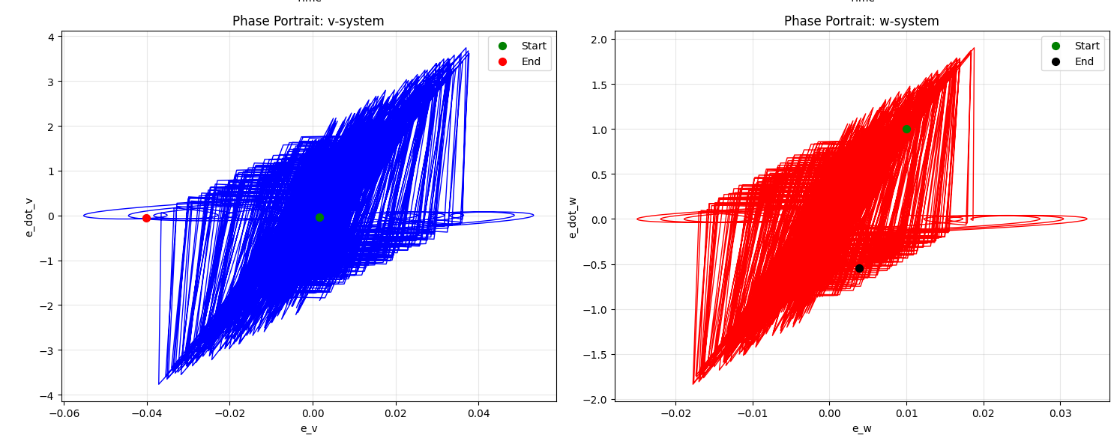
PHASE PORTRAIT DATA ANALYSIS

Slide 6
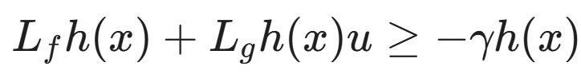
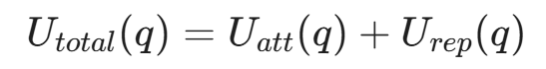
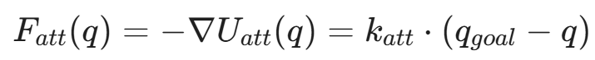
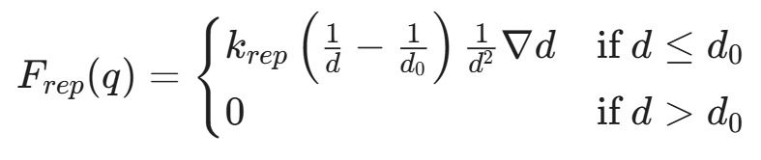
MOTION PLANNING
Safety Condition First! (Control Barrier Function): The inequality that guarantees the robot remains in the safe set (ℎ(𝓍) ≥ 0):
Total Potential Field: The sum of attractive and repulsive forces acting on the robot:
Attractive Force (Goal):
Repulsive Force (Obstacle): Active only when distance to obstacle (𝑑) is less than influence range (𝑑₀):

Slide 7
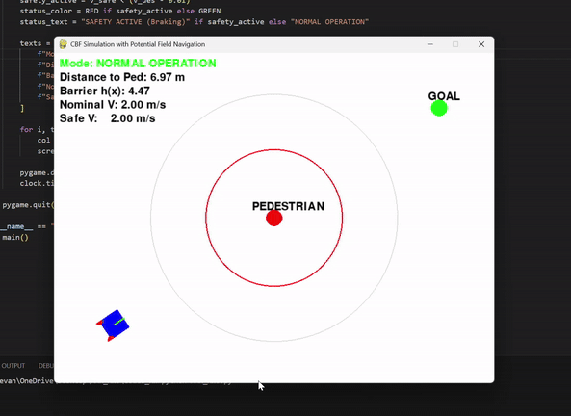
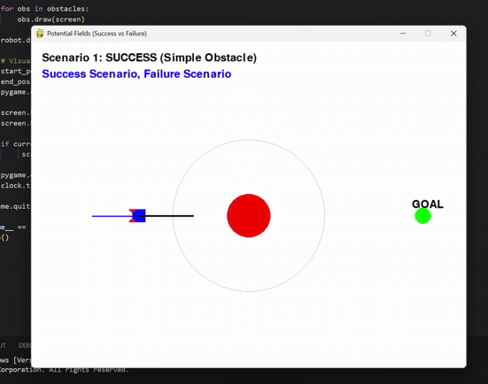
OBSTACLE AVOIDANCE
Using Control Barrier Function
Potential Field demonstration with its limits

Slide 8
RESULTS & PERFORMANCE
Simulation Environment: Created a custom simulator with:
Dynamic HUD showing velocity and status.
Randomized environments (Polygons, Pedestrians, Traps).
Respecting non-holonomic constraints
Achievements:
Successful navigation in complex, cluttered environments.
Visualized "Safe Zones" appearing dynamically around pedestrians.
Implemented a "Predicted Path" visualization to show the planner's intent.

Slide 9
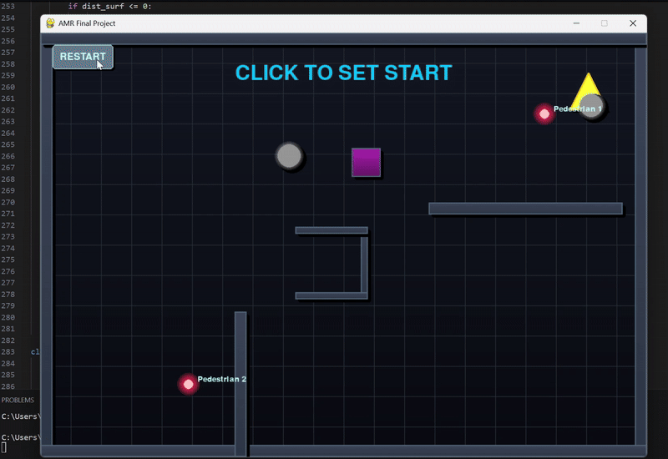
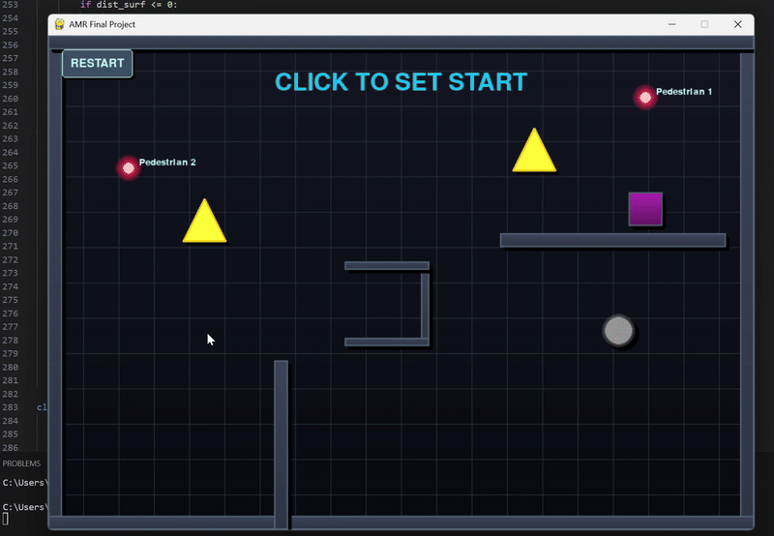
Navigating through the environment avoiding pedestrians, walls & obstacles
Potential Field Failure when getting stuck in U trap

Slide 10
CHALLENGES & APPROACHES
Challenges
Old (SMC): u = -K * sign(s). This switches violently between +K and -K when error is near zero, causing the robot to shake or rotate aggressively.
Infinite force spikes near obstacles as 1/𝑑² approaches infinity which will demand infinite acceleration/velocity from the robot’s motors.
Dynamic obstacles causing planner instability.
Solutions
New (Robust SMC with Boundary): u = -K * tanh(s / phi). This creates a smooth transition when the error is small, eliminating the chattering while maintaining robust tracking.
Solution: Implemented force saturation clamping to respect physical actuator limits.
Layered architecture: APF for global guidance, CBF for hard safety guarantees.

Slide 11
Thank you
! GitHub Link !

